Slide 1


Regulatory Reporting UK & USA
Daniel Mena
Oct, 2024

Slide 2

Introduction
Wise is a global fintech specializing in fast, transparent, and affordable cross-border payments, serving millions worldwide.
With operations across multiple countries, we prioritize strict adherence to diverse regulations. This presentation focuses on meeting specific regulatory requests (R1 & R2).

Slide 3
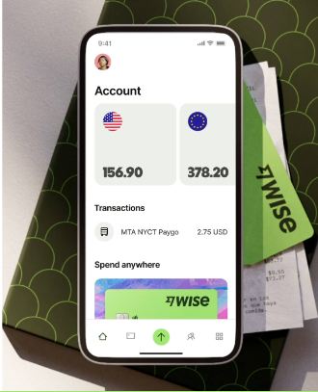
Objectives
Present a reliable data reporting process for regulatory compliance.
Analyze data to meet R1 & R2 requirements.
Propose improvements for data quality and reporting

Slide 4
Regulatory Requests (R1 & R2)
R1
Total cross-currency volume in GBP processed by the UK Entity (April 2022 – August 2023).
R2
Cross-currency volume in GBP by the US Entity (April 2022 – August 2023).
Same-currency volume in GBP by the US Entity (April 2022 – August 2023).

Slide 5




Data Workflow
Manuals
Upload Files
Data Analysis
Reports
Documentation ensures consistency. Includes data dictionaries, process descriptions, and version control.
Python scripts extract, validate, and load data from Excel to BigQuery.
Data profiling identifies issues. Handling nulls and negative values is addressed with justifications.
SQL queries aggregate data to meet R1 & R2 requirements. Reports include visual summaries.

Slide 6
Data Summary & Caveats
Data Caveats
4 missing Customer_Type data cases.
Negative Amount_GBP values need further investigation.
Potential duplicate transaction IDs.
Key Stats
Total Transactions: 90
Unique Customers: 67
Avg Transaction: 491 GBP
UK market: 34%

Slide 7

Addressing Data Issues
Missing Customer_Type
Short-term: Label missing Customer_Type as "Unknown".
Long-term: Enrich data or predict Customer_Type via behavior.
Negative Amount_GBP
Review negative transactions and create rules to classify them accurately.

Slide 8

Immediate Submission Strategy
Key Actions
Focus on R1 & R2 data extraction.
Transparently report limitations due to data quality.
Propose data quality initiatives for future reporting.

Slide 9

Technology & Deliverables
Technologies
BigQuery: For scalable data handling.
Python: For data processing and automation.
Deliverables
Python scripts, SQL queries and regulatory reports.

Slide 10

Stakeholder Alignment
Ensuring Accuracy
Regular communication with regulators.
Maintain a comprehensive data dictionary.
Host meetings to align on key definitions.

Slide 11

Aitäh!
küsimusi mulle?

